Slide 1




z
Micro Credit Defaulter Report
PREPARED BY
LakshmiPraneetha
sidda

Slide 2
Part 01
Problem statement
CONTENTS
Part 02
Data Vizualization
Part 03
Interpretation of the results
Part 04
Conclusion

Slide 3
INTRODUCTION
z

Slide 4
A case study to predict in terms of a probability for each loan transaction,
whether the customer will be paying back the loaned amount
within 5 days of insurance of loan.

Slide 5
z
Business Problem Framing
The main objective of this project is to build a model which can be used to predict in terms of a probability for each loan transaction, whether the customer will be paying back the loaned amount within 5 days of insurance of loan.

Slide 6
z
Many microfinance institutions (MFI), experts and donors are
supporting the idea of using mobile financial services (MFS) which
they feel are more convenient and efficient, and cost saving, than
the traditional high-touch model used since long for the purpose of
delivering microfinance services. Though, the MFI industry is
primarily focusing on low income families and are very useful in
such areas, the implementation of MFS has been uneven with both
significant challenges and successes.
Conceptual Backgroud of the Domain Problem

Slide 7
z
Our dataset contains the default status of the users along with the features.
The dataset contains 209593 rows and 36 columns including the target column.
'label' is the target column.
Let’s have a look at the feature columns and its description.
Data Description

Slide 8
S. No. | Variable | Definition | Comment
1 | label | Flag indicating whether the user paid back the credit amount within 5 days of issuing the loan{1:success, 0:failure}
2 | msisdn | mobile number of user
3 | aon | age on cellular network in days
4 | daily_decr30 | Daily amount spent from main account, averaged over last 30 days (in Indonesian Rupiah)
5 | daily_decr90 | Daily amount spent from main account, averaged over last 90 days (in Indonesian Rupiah)
6 | rental30 | Average main account balance over last 30 days | Unsure of given definition
7 | rental90 | Average main account balance over last 90 days | Unsure of given definition
8 | last_rech_date_ma | Number of days till last recharge of main account
9 | last_rech_date_da | Number of days till last recharge of data account
10 | last_rech_amt_ma | Amount of last recharge of main account (in Indonesian Rupiah)
11 | cnt_ma_rech30 | Number of times main account got recharged in last 30 days
12 | fr_ma_rech30 | Frequency of main account recharged in last 30 days | Unsure of given definition

Slide 9
S. No. | Variable | Definition | Comment
13 | sumamnt_ma_rech30 | Total amount of recharge in main account over last 30 days (in Indonesian Rupiah)
14 | medianamnt_ma_rech30 | Median of amount of recharges done in main account over last 30 days at user level (in Indonesian Rupiah)
15 | medianmarechprebal30 | Median of main account balance just before recharge in last 30 days at user level (in Indonesian Rupiah)
16 | cnt_ma_rech90 | Number of times main account got recharged in last 90 days
17 | fr_ma_rech90 | Frequency of main account recharged in last 90 days | Unsure of given definition
18 | sumamnt_ma_rech90 | Total amount of recharge in main account over last 90 days (in Indonasian Rupiah)
19 | medianamnt_ma_rech90 | Median of amount of recharges done in main account over last 90 days at user level (in Indonasian Rupiah)
20 | medianmarechprebal90 | Median of main account balance just before recharge in last 90 days at user level (in Indonasian Rupiah)
21 | cnt_da_rech30 | Number of times data account got recharged in last 30 days
22 | fr_da_rech30 | Frequency of data account recharged in last 30 days
23 | cnt_da_rech90 | Number of times data account got recharged in last 90 days
24 | fr_da_rech90 | Frequency of data account recharged in last 90 days

Slide 10
S. No. | Variable | Definition | Comment
25 | cnt_loans30 | Number of loans taken by user in last 30 days
26 | amnt_loans30 | Total amount of loans taken by user in last 30 days
27 | maxamnt_loans30 | maximum amount of loan taken by the user in last 30 days | There are only two options: 5 & 10 Rs., for which the user needs to pay back 6 & 12 Rs. respectively
28 | medianamnt_loans30 | Median of amounts of loan taken by the user in last 30 days
29 | cnt_loans90 | Number of loans taken by user in last 90 days
30 | amnt_loans90 | Total amount of loans taken by user in last 90 days
31 | maxamnt_loans90 | maximum amount of loan taken by the user in last 90 days
32 | medianamnt_loans90 | Median of amounts of loan taken by the user in last 90 days
33 | payback30 | Average payback time in days over last 30 days
34 | payback90 | Average payback time in days over last 90 days
35 | pcircle | telecom circle
36 | pdate | date

Slide 11
Data Visualization

Slide 12
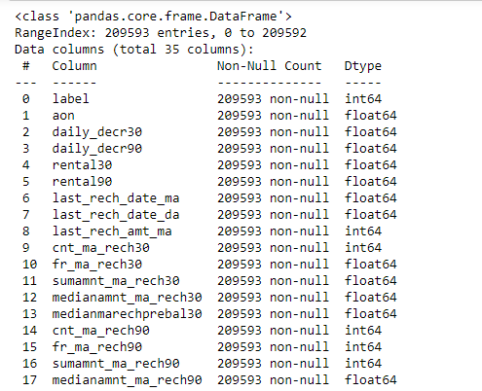
z
The datatypes of the dataset are as follows:

Slide 13
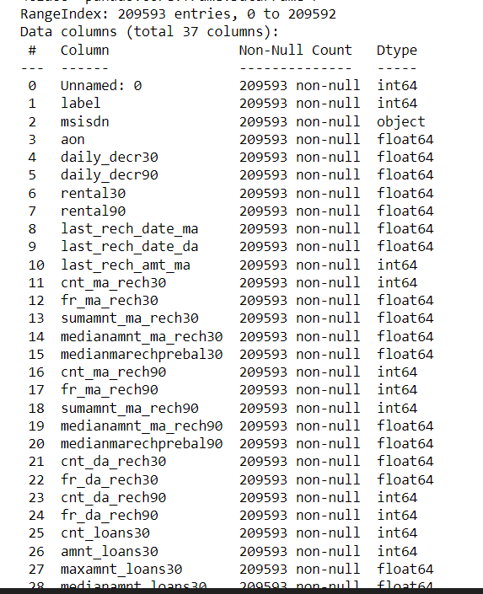
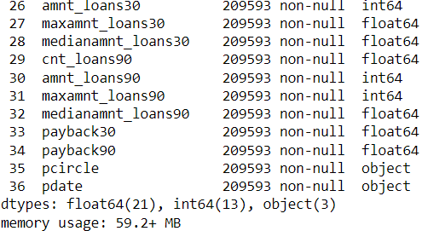

Slide 14
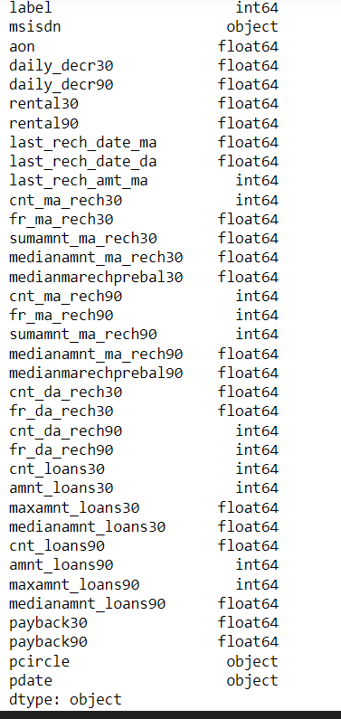
df.dtypes
z

Slide 15
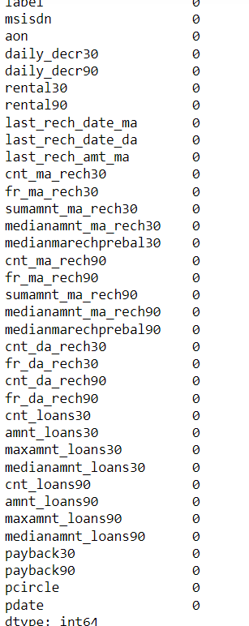
Null values
No null values are present in the dataset
z

Slide 16
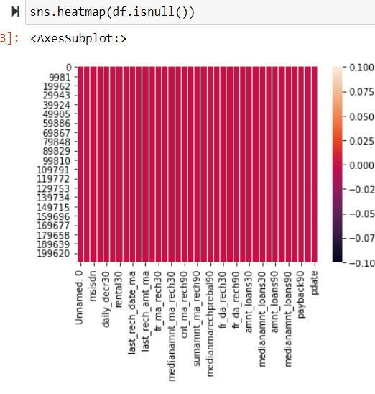
Heatmap for null values
z

Slide 17
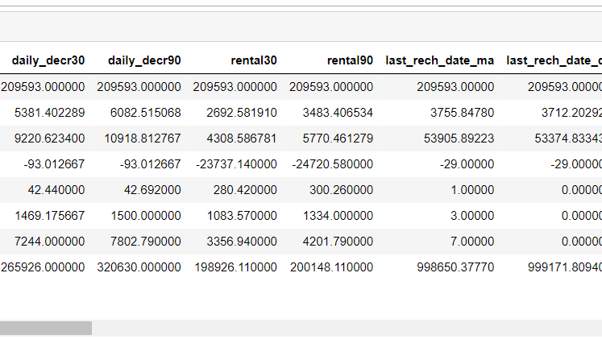
STATISTICAL SUMMARY
z

Slide 18
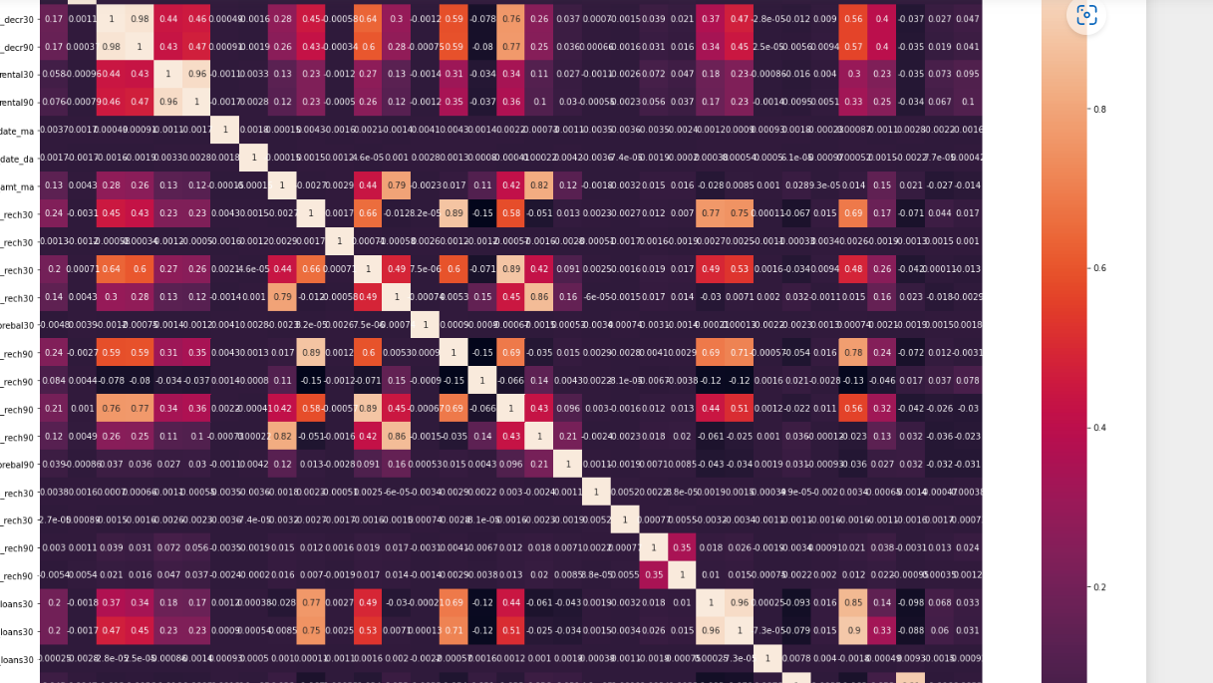
Heatmap for correlation
z

Slide 19
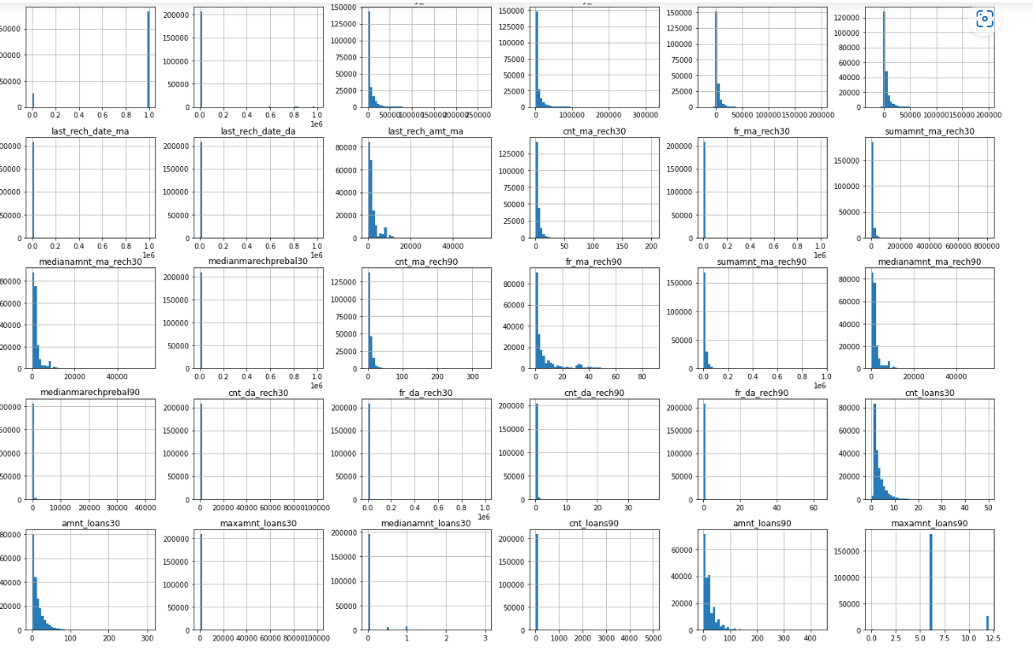
Histogram of the dataset
z

Slide 20
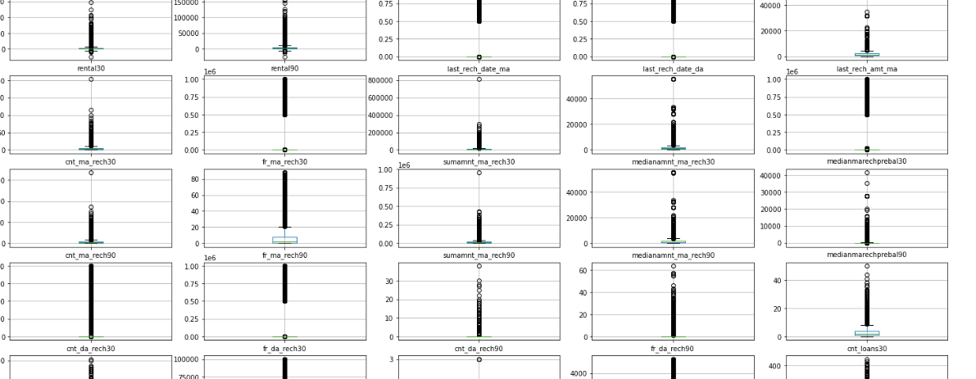
outliers
z
Outliers are present in the dataset

Slide 21
An outlier is an object that deviates significantly from the rest of the objects. They can be caused by measurement or execution error. The analysis of outlier data is referred to as outlier analysis or outlier mining.
It is a data point that is noticeably different from the rest. They represent errors in measurement, bad data collection, or simply show variables not considered when collecting the data.

Slide 22
Outcomes of Correlation Table:
Number of times account got recharged in 30 days & 90 days have the maximum correlation with the target column. It have 24% correlation which can be considered as strong bond.
Total amount of recharge in main account over last 90 days have 21% correlation with the target column which can be considered as strong bond.
Total amount of recharge in main account over last 30 days, Number of loans taken by user in last 30 days, total amount of loans taken in 30 days, and 90 days columns are showing 20% correlation with the target column which can be considered as good bond.

Slide 23
Interpretation of
the results

Slide 24
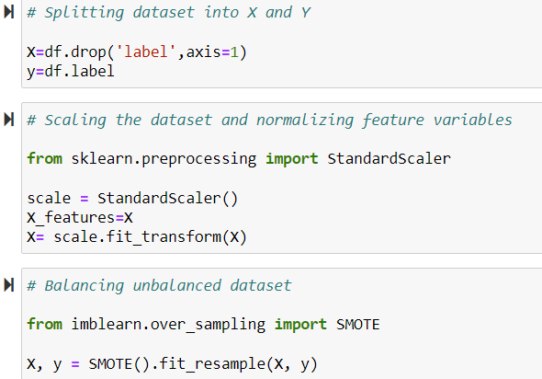
Splitting,scaling and balancing the dataset
z

Slide 25
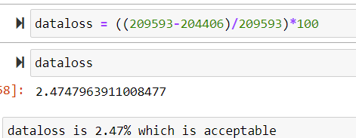
DATALOSS
z

Slide 26
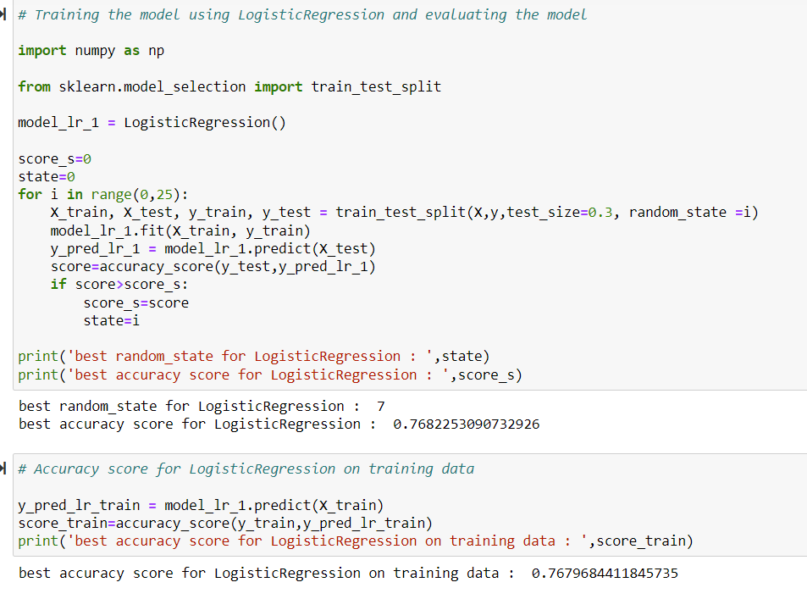
Evaluation of Models
z

Slide 27
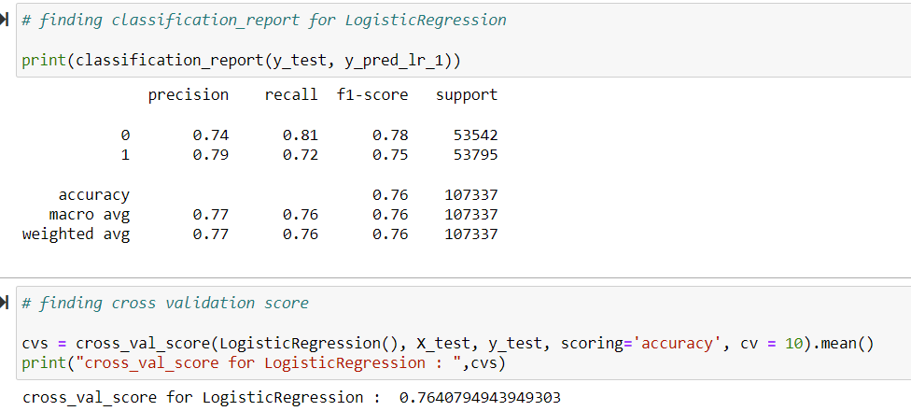

Slide 28
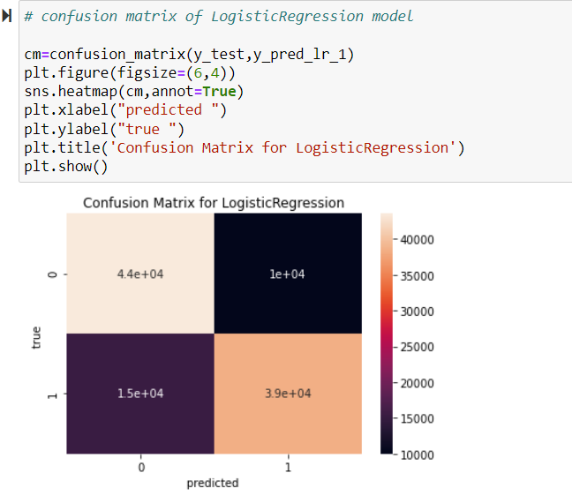

Slide 29
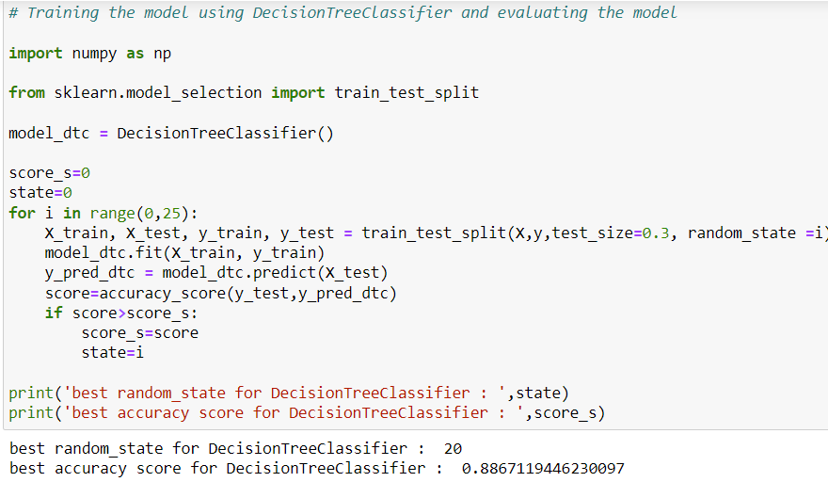

Slide 30
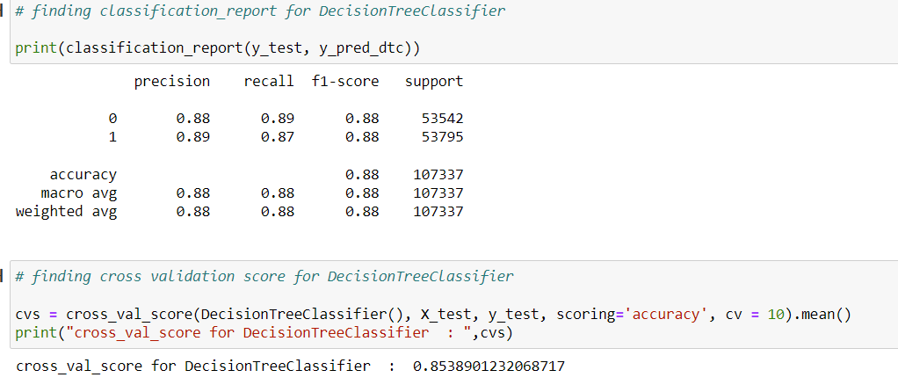

Slide 31
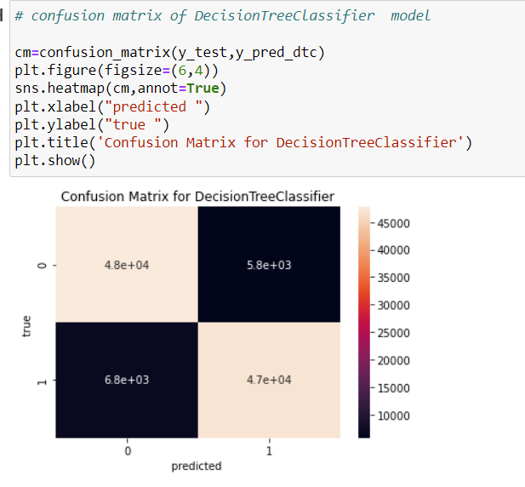

Slide 32
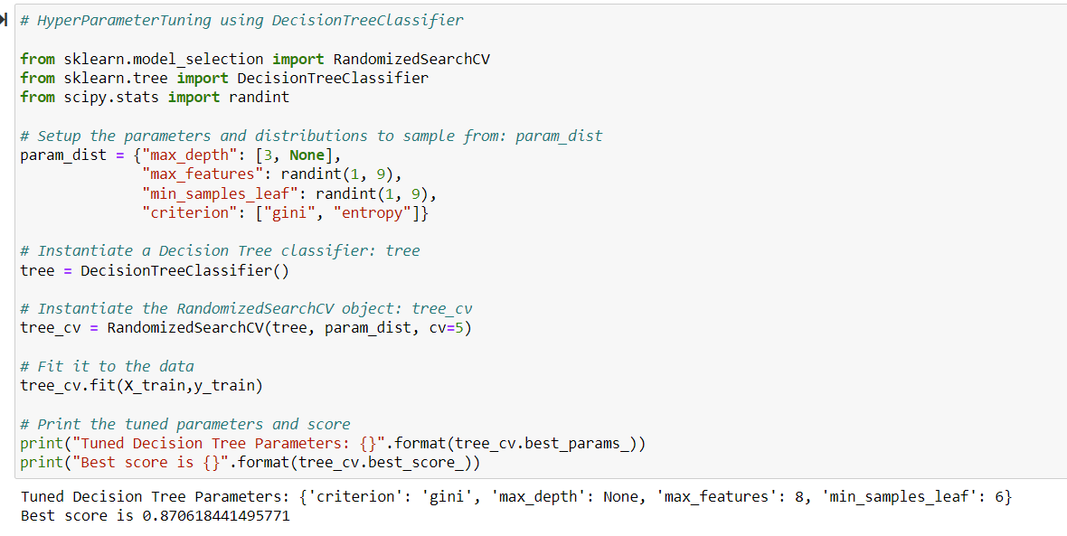

Slide 33
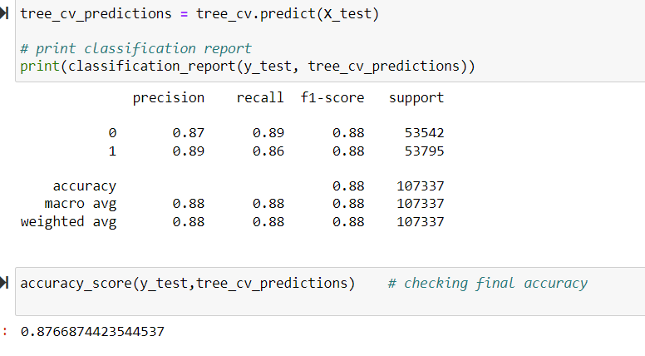

Slide 34
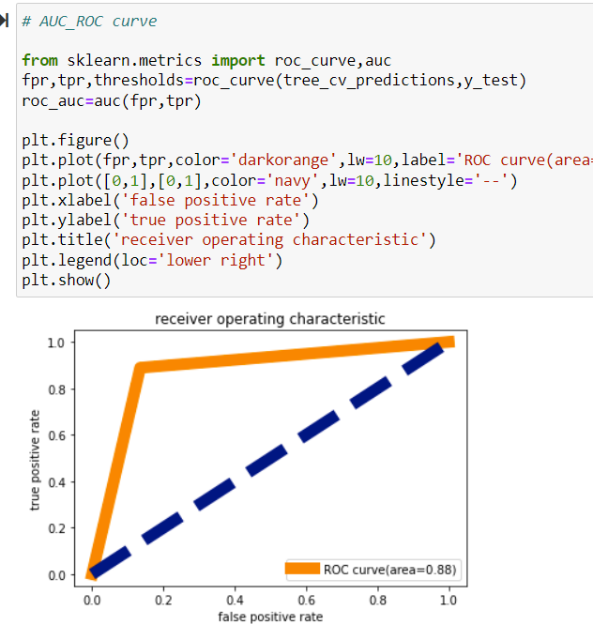
AUC-ROC CURVE
z

Slide 35
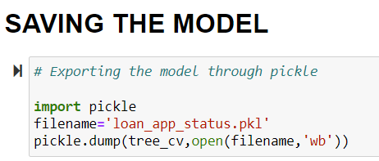
Saving the Model
z

Slide 36
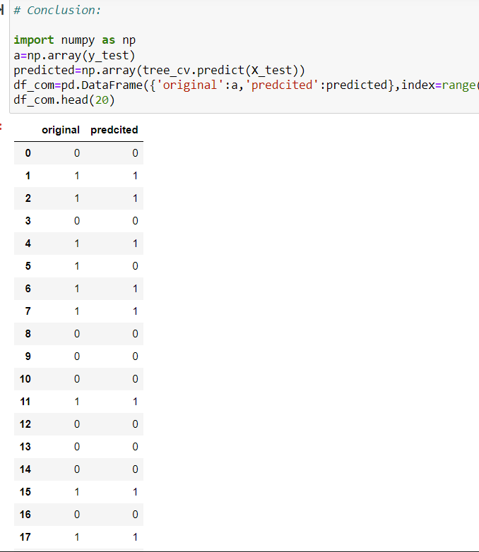
Conclusion
z

Slide 37

DECISION TREE CLASSIFIER IS THE BEST FIT MODEL FOR THIS DATASET

Slide 38
Conclusion
Key Findings:
If the number of days of payback is increasing the chance of defaulters is also increasing. So, we should look for the payback duration.
If the loan amount is below 100 and the number of loans taken by users is 90 days, the number of defaulters is increasing.

Slide 39
The following types of users are generally defaulters
Users who uses the services for shoort time.
Users whose avaerage daily spend amount is less.
Users whose main account balance is low.
Users who do not recharge frequently or they recharge for very few times in the last 30 or 90 days.
Users whose reacharge amount is less.
Users who opt for less amount of loan are more defaulter as compared to the users who opt for loan more amount.

Slide 40
THANK YOU

